Slide 1
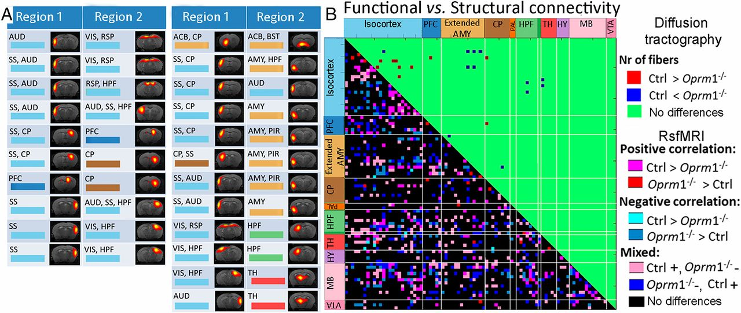
Limited alteration of tractography-based structural compared with FC in Oprm1−/− mice.
Anna E. Mechling et al. PNAS 2016;113:11603-11608
©2016 by National Academy of Sciences
Notes:
Limited alteration of tractography-based structural compared with FC in Oprm1^{−/−} mice. (A) Modifications of internode structural connectivity: changes were assessed based on the number of fibers directly connecting functional nodes of the brain connectivity matrix (between region 1 and region 2). (Left) Significant change in fiber numbers Ctrl > Oprm1^{−/−}. (Right) Significant change in fiber numbers Oprm1^{−/−} > Ctrl. (B) Direct comparison of significant functional and structural connectivity showed widespread FC modifications in mutant mice, whereas structural adaptations were limited. The few alterations of structural connectivity determined from tractography included SS, AMY, and ACB, as well as SS–AMY connections. Diffusion tractography also showed remodeling within ACB (A, first row right) in MOR depleted brains but no modification for midbrain centers (i.e., PAG).

